Slide 1

Introduction to Computer Vision and Image Analytics

Slide 2
Contents
What is Computer Vision
Image and Video Analytics
Challenges in Computer Vision/Image/Video Analytics
Digital Representation of Images

Slide 3
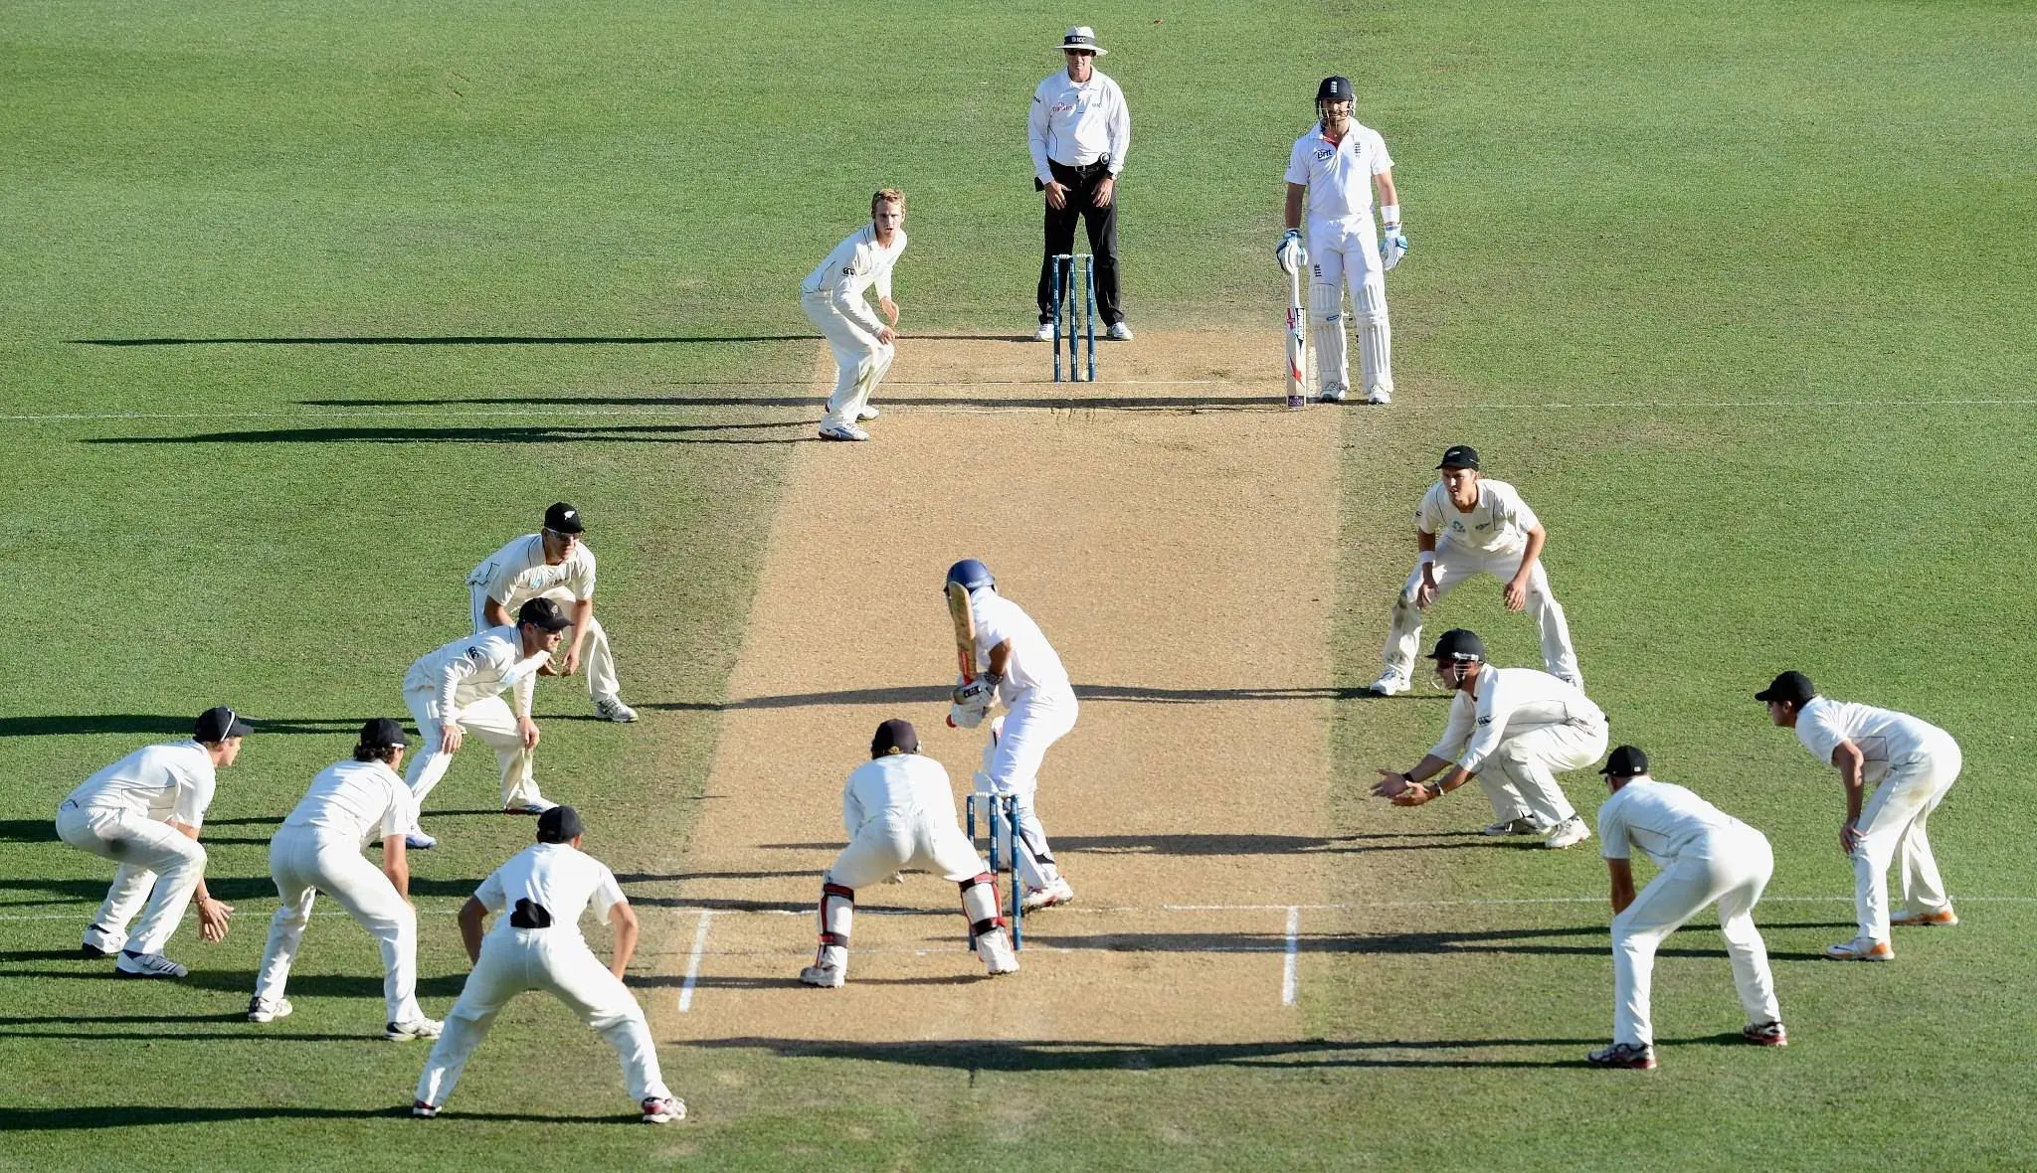
What is Computer Vision?
Area of study with following objectives:
to enable computers (systems) to see
to develop algorithms which can deduce and reason based on what is seen
Seeing an image involves the following:
To recognise where objects are in the image
To gauge the properties of the objects
To understand what the object is doing
What can you say about this image?

Slide 4
Image and Video Analytics
Performing analysis and making predictions based on information available in the form of images and videos
Image and Video analytics are based on ideas of Computer Vision and tools from Deep Learning
Question: What is Deep Learning?
Deep learning is a branch of Machine Learning
Involves developing algorithms inspired by the structure and functioning of human brain
Uses artificial neural networks to learn and perform tasks
Convolution neural networks are used to perform computer vision tasks or image/video analytics

Slide 5
Challenges in Computer Vision/Image/Video Analytics

Slide 6
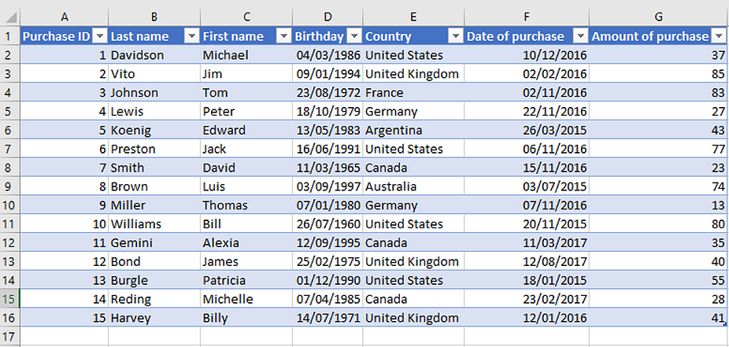
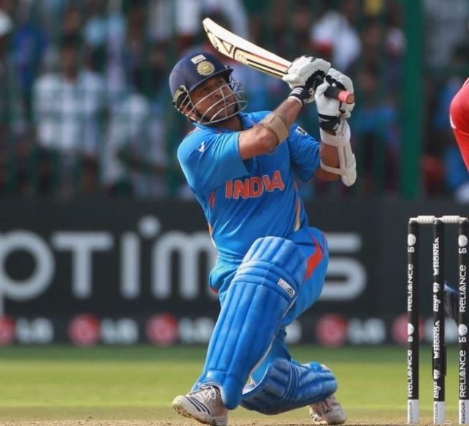
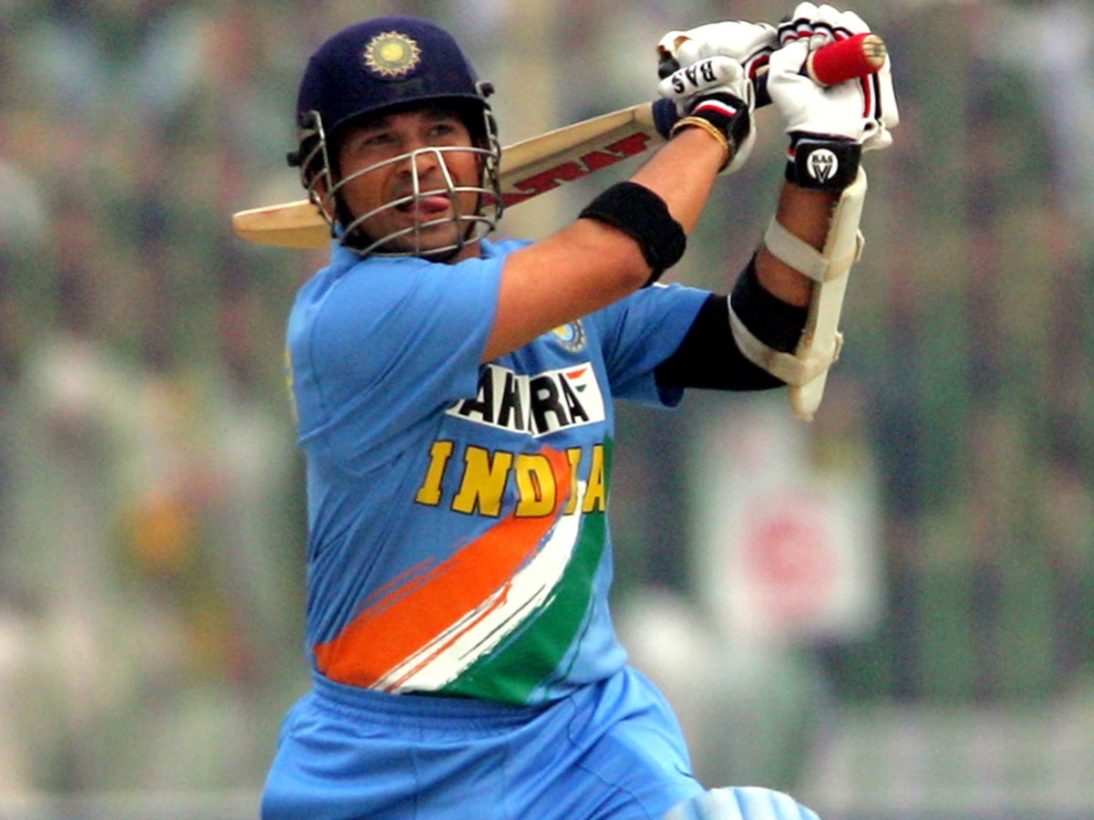
Structured Vs Unstructured Data
Structured data:
Highly organised and formatted form of data
Can be put in the form of rows and columns of tables
Searching for specific information is easy
Un-structured data:
Have no pre-defined structure and takes to diverse forms
Images, videos, text, audio files, etc. are forms of unstructured data
Almost 80% of data is unstructured
Unstructured data can be easily processed and understood by humans
However, it is hard to make a computer understand unstructured data

Slide 7

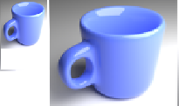
Challenges in Computer Vision
What seems like a common task for humans (visual recognition), is a big challenge for computers
Viewpoint variation: Different orientations of the image with respect to the camera.
Scale variation: Different sizes of the object with respect to the image size.

Slide 8
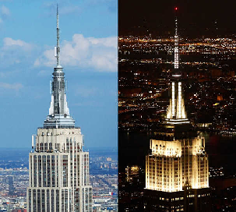
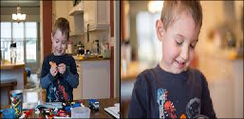
Challenges in Computer Vision
Illumination conditions may vary from time to time
Background clutter: Varying backgrounds

Slide 9

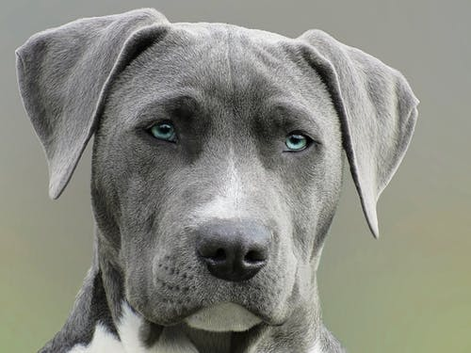
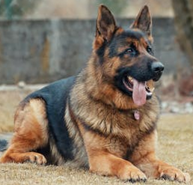

Challenges in Computer Vision
Same type of objects can look very different in the real world
How to overcome these challenges?
Deep Learning based on Convolution Neural Networks to the rescue

Slide 10
How to represent Images in a Computer?

Slide 11
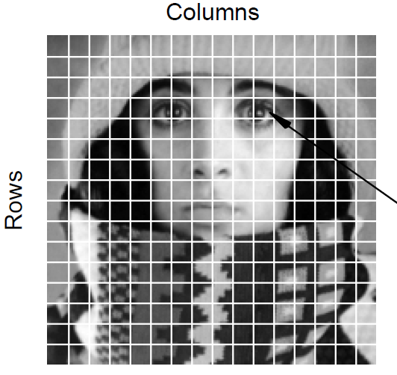



Digital Image
A digital image consists of pixels arranged in rows and columns
Pixels are little squares filled with a colour shade
There is a value associated with each pixel representing the intensity of the colour
Typically this value lies between 0 and 255 (8-bit integer)
So digital image can be seen as a matrix of pixel values
$$y$$
$$x$$
$$p=f(x,y)$$

Slide 12
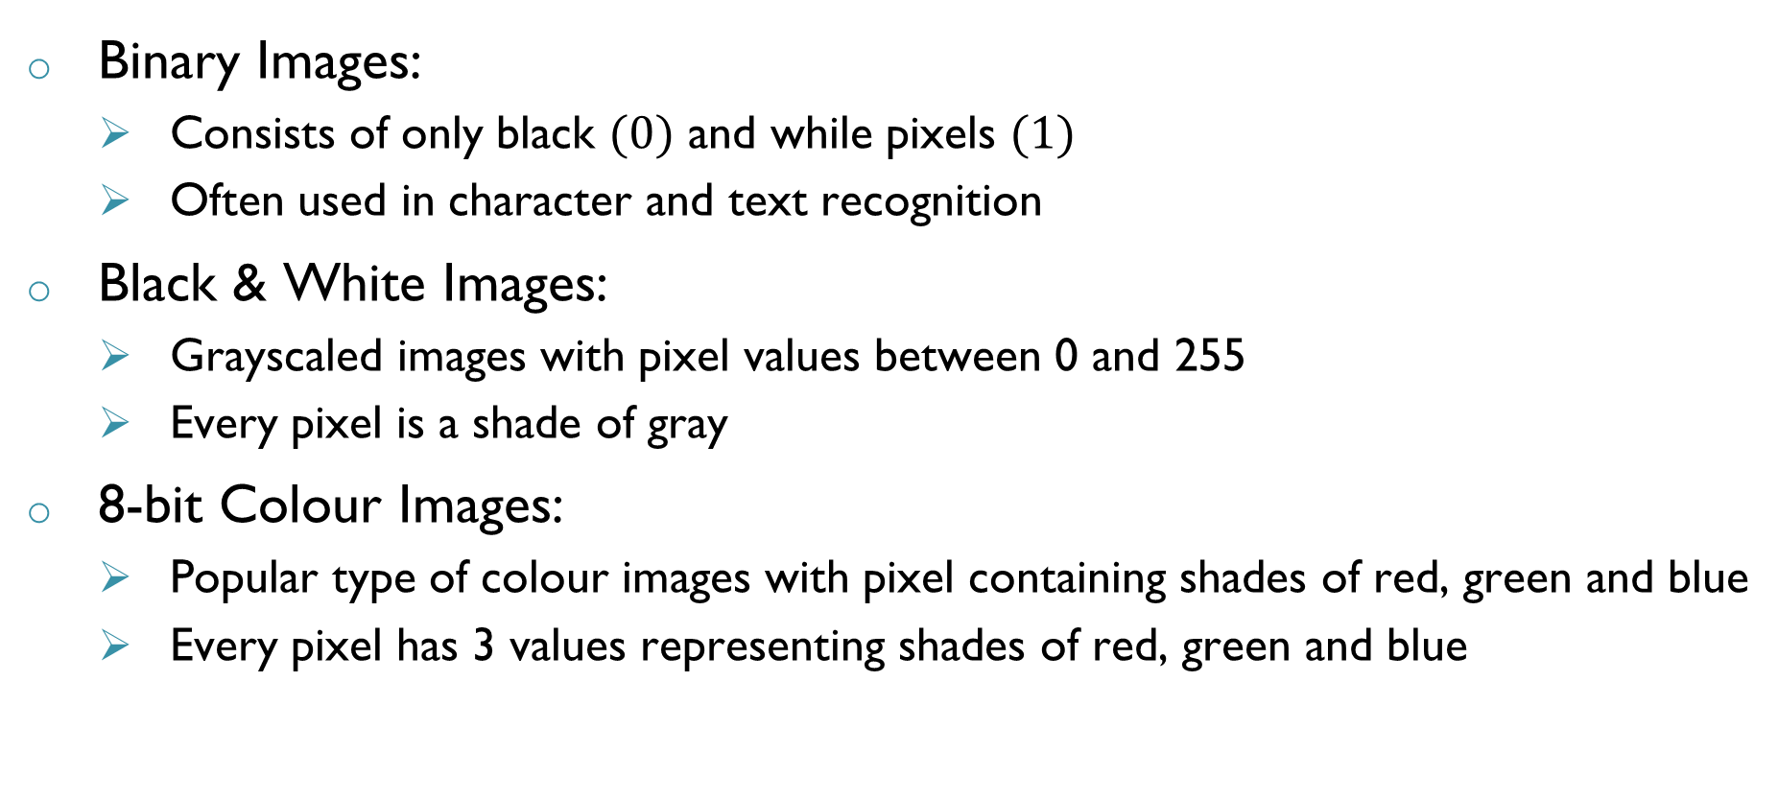
Types of Images
Binary Images:
Consists of only black $(0)$ and while pixels $(1)$
Often used in character and text recognition
Black & White Images:
Grayscaled images with pixel values between 0 and 255
Every pixel is a shade of gray
8-bit Colour Images:
Popular type of colour images with pixel containing shades of red, green and blue
Every pixel has 3 values representing shades of red, green and blue

Slide 13
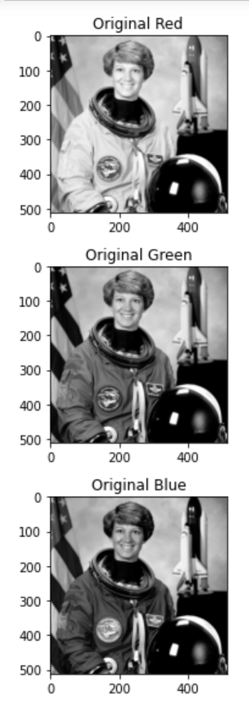
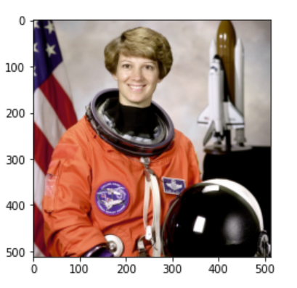
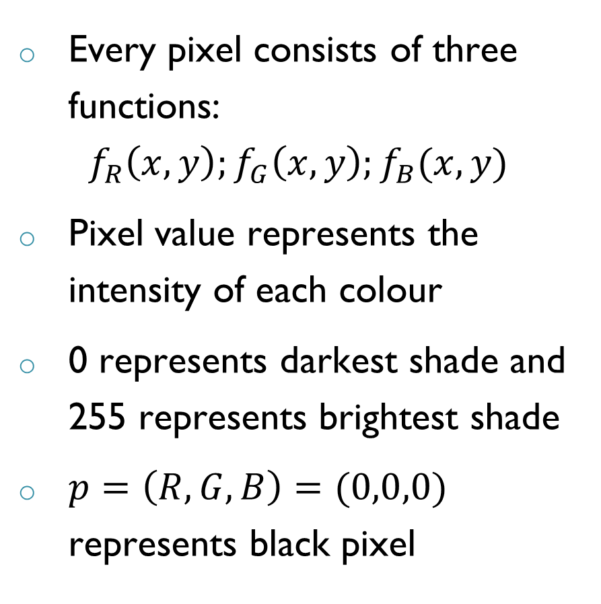
Color Images
Every pixel consists of three functions:
$$f_{R}\left(x,y\right);f_{G}\left(x,y\right);f_{B}(x,y)$$
Pixel value represents the intensity of each colour
0 represents darkest shade and 255 represents brightest shade
$p=\left(R,G,B\right)=(0,0,0)$ represents black pixel

Slide 14
Summary
Computer Vision is an area of AI which involves developing techniques to extract and deduce information from images/videos
Different challenges exist in making computers understand and extract information from an image
Digital image consists of information in the form of pixel values which indicate brightness of a colour in an image
Colour images can be presented using three layers of pixel values with each layer corresponding to a shade of Red, Blue and Green

Slide 15

THANK YOU

